Slide 1


Hospital Management System
Team 04
11 - 02 - 2023
© 2018 QuEST Global Services Pte Ltd. The information in this document is the property of QuEST Global Services Pte Ltd. and may not be copied or communicated to a third party or used for any purpose other than that for which it is supplied without the written consent of QuEST Global Services Pte Ltd.
1 | © 2018 QuEST Global Services Pte Ltd. Confidential

Slide 2
Coverage
Overview of the project
Requirement & GUIs
High Level Design
Individual contribution
Challenges faced & how it addressed
Experience gained
2

Slide 3
Overview
The Hospital Management System includes four modules. They are Admin, Doctor, Reception and Pharmacy.
The admin can register doctor, pharmacist and receptionist and admin can view the dashboard which contain list of patients, appointment and total earning of the hospital.
The doctor can manage the patient treatment and he can view the patients whom he will treat and also he can search his appointment and assign the medicine.
The pharmacist can manage medicines like adding medicines and company, distributor and also update and delete the medicines.
The receptionist can registration of the patient and appoint the patient to a doctor and after treatment he can make bill for the patient.
2

Slide 4
High level design
The HLD will:
• present all of the design aspects and define them in detail.
• describe the user interface being implemented.
• describe the hardware and software interfaces.
• describe the performance requirements.
• include design features and the architecture of the project.
5 | © 2018 QuEST Global Services Pte Ltd.
5
Confidential

Slide 5
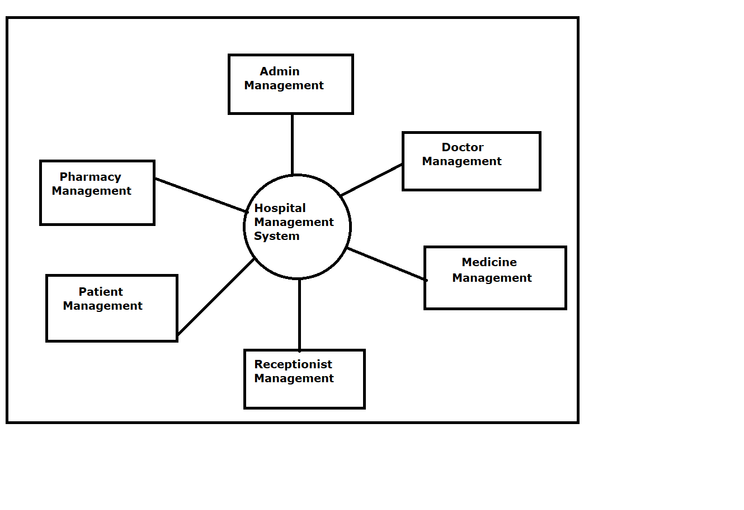
High Level Design
Web Application Architecture
4 | © 2018 QuEST Global Services Pte Ltd.
Confidential

Slide 6
Sample Code Snippets
@Entity
public class Admin {
@Id
@GeneratedValue(strategy=GenerationType.IDENTITY)
@Column(name="Id")
private int id;
@Column(name="FirstName")
private String firstname;
@Column(name="LastName")
private String lastname;
@Column(name="UserName")
private String username;
@Column(name="EmailId")
private String emailid;
@Column(name="Password")
private String password;
@Column(name="MobileNo")
private String mobileno;
@Column(name="Street")
private String street;
@Column(name="City")
private String city;
@Column(name="Pincode")
private String pincode;

Slide 7
Requirement & GUIs
Spring MVC
Hibernate and JPA
JSP (JavaServer Pages)
MySQL
Tomcat Server
Maven

Slide 8
Sample Code Snippets
package com.hospitalmanagement.service;import java.util.List;import com.hospitalmanagement.model.Doctor;public interface DoctorService { Doctor addDoctor(Doctor doctor);
void deleteDoctorById(Integer id);
Doctor getDoctorById(Integer id);
Doctor updateDoctor(Doctor doctor);
Doctor loginDoctor(String username, String password); List<Doctor> getAllDoctors();
Long getDoctorsTotalCounts();
Long getDoctorsCountByDate(String registereddate); List<Doctor> getDoctorsByName(String doctorName);
}

Slide 9
Individual contribution
Vijay N S
Pharmacist Module
Amulya P S
Admin Module
Snehal Mahajan
Receptionist Module
Shubham Pore
Doctor Module

Slide 10
Challenges faced & how it addressed
Have faced a challenge in different phases like easy, medium and hard challenges.
Where as some challenges which required basics thinking and calculations were faced individually.
In some situations hard challenges were faced with team members like logic and solving errors as there were different mindset and skill present in our team we used it in a right way to get things done which are related to our project.
So, from handling these type of situations we learned how to overcome difficult challenges and on time awareness.
Time Shortage: We had less time to complete this project. So we distributed the work in the group.
10 | © 2018 QuEST Global Services Pte Ltd.
10

Slide 11
Experience gained
Project management
Team collaboration
Communication skills
Technical skills
Problem-solving
Adaptability
Time management
Leadership
11 | © 2018 QuEST Global Services Pte Ltd.
10

Slide 12
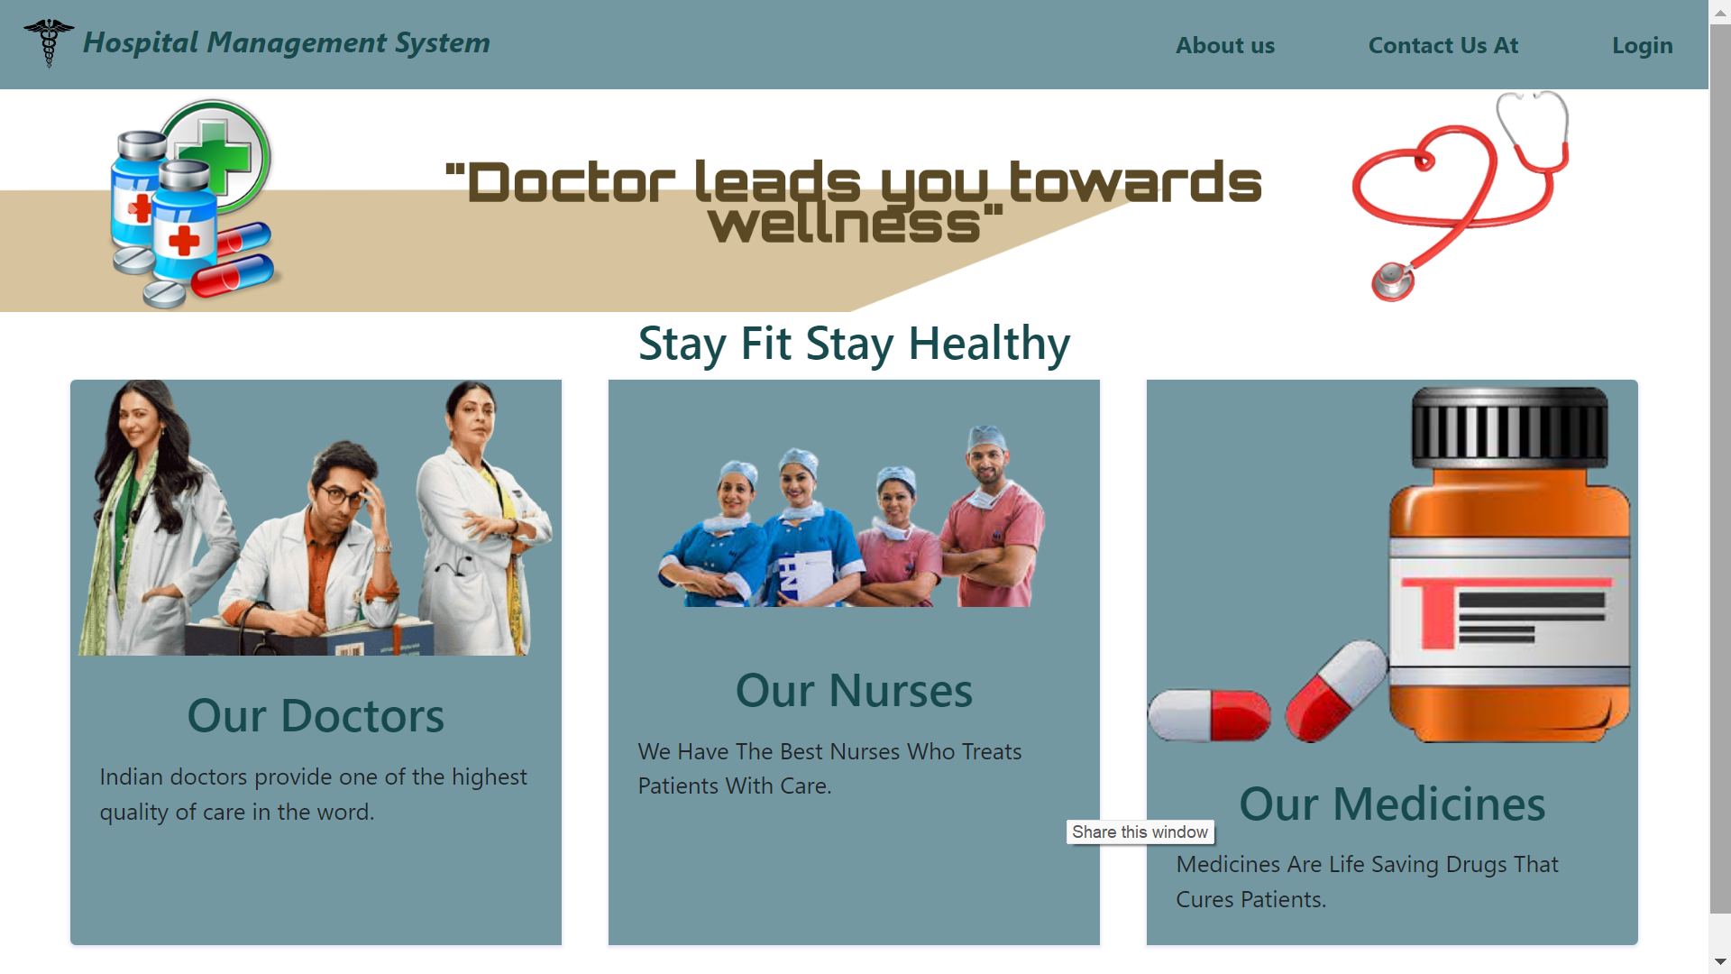
Demo
Home
12 | © 2018 QuEST Global Services Pte Ltd.
10

Slide 13
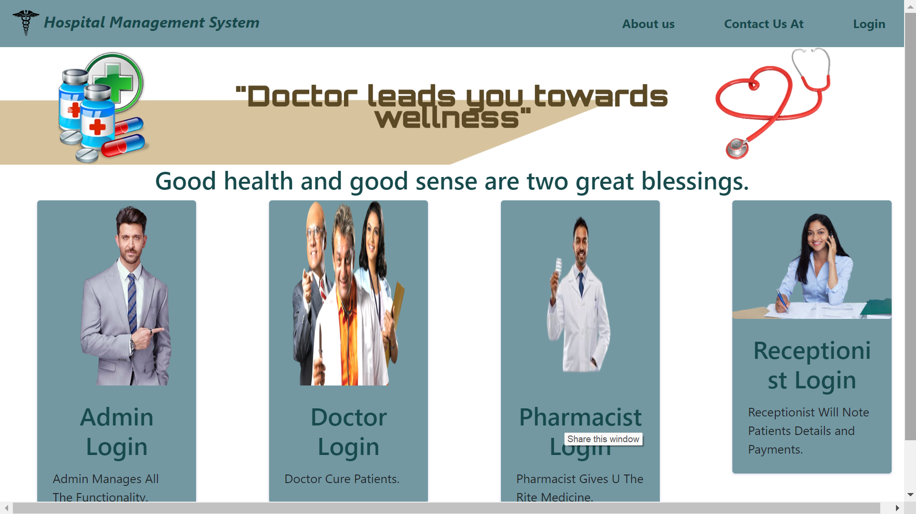
Demo
Login
13 | © 2018 QuEST Global Services Pte Ltd.
10

Slide 14
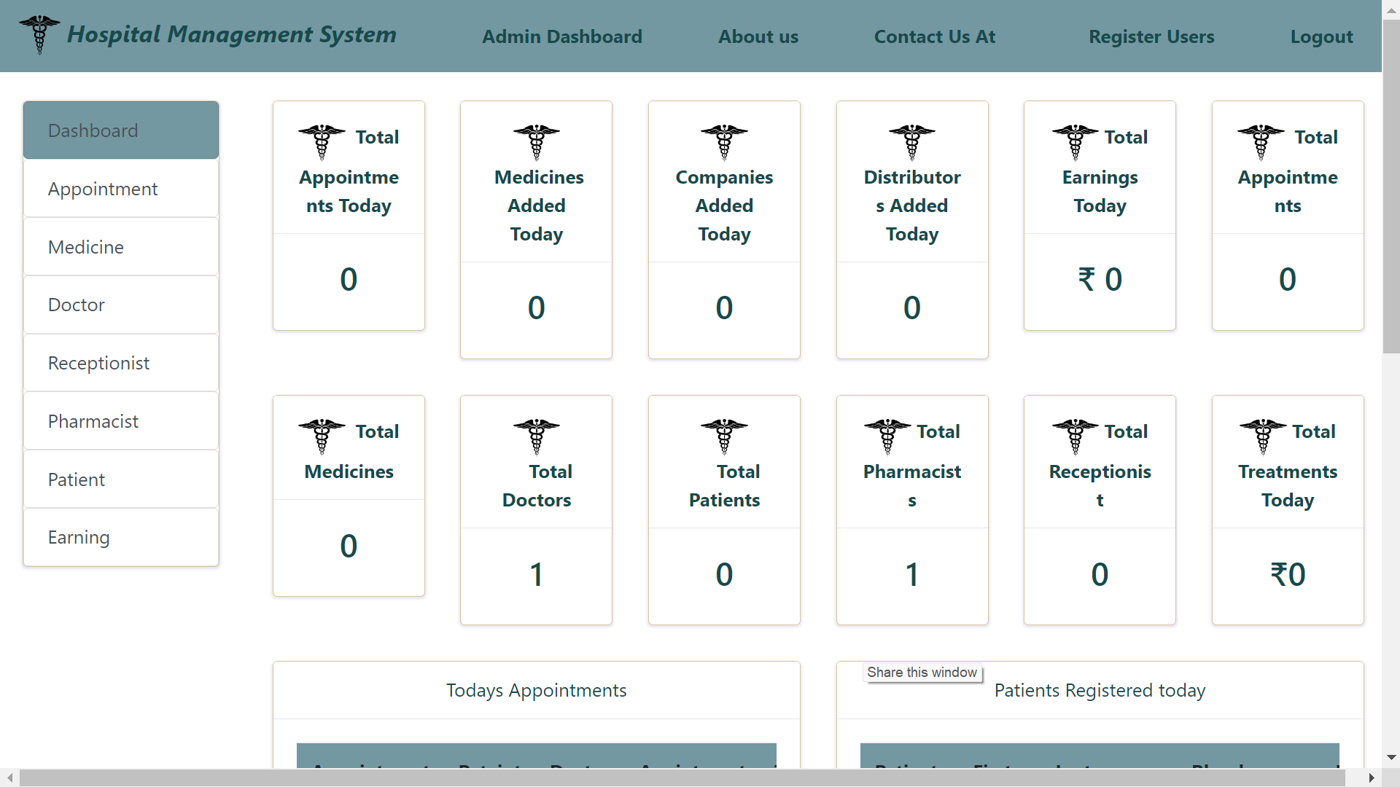
Demo
Admin Dashboard
14 | © 2018 QuEST Global Services Pte Ltd.
10

Slide 15
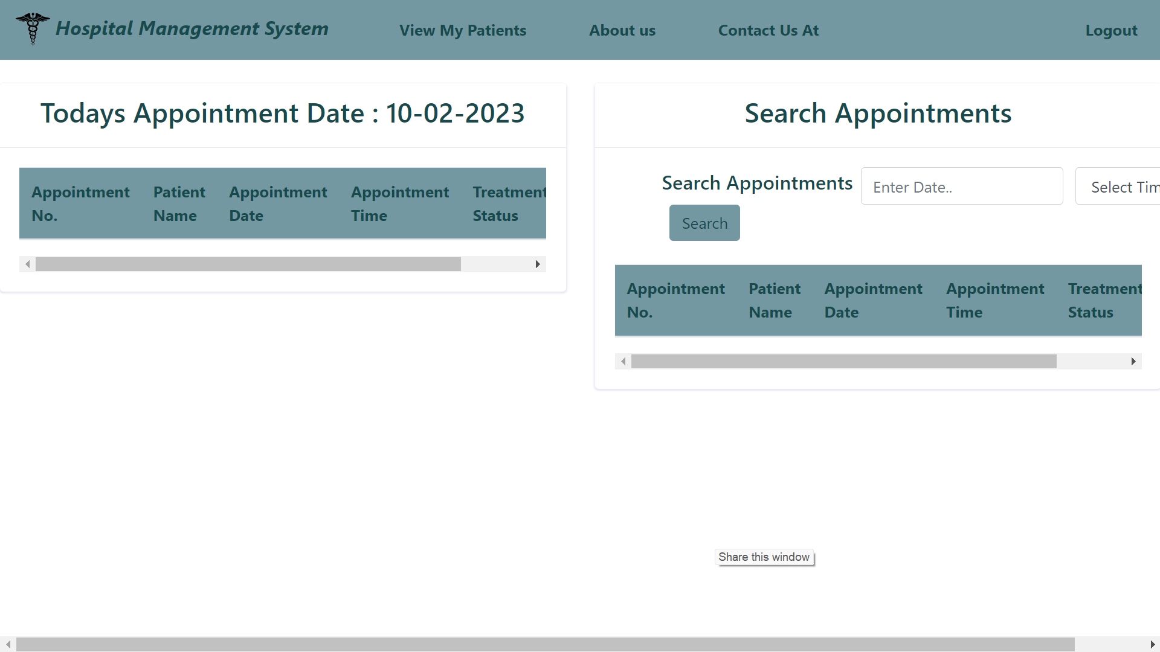
Demo
Doctor Login
15 | © 2018 QuEST Global Services Pte Ltd.
10

Slide 16
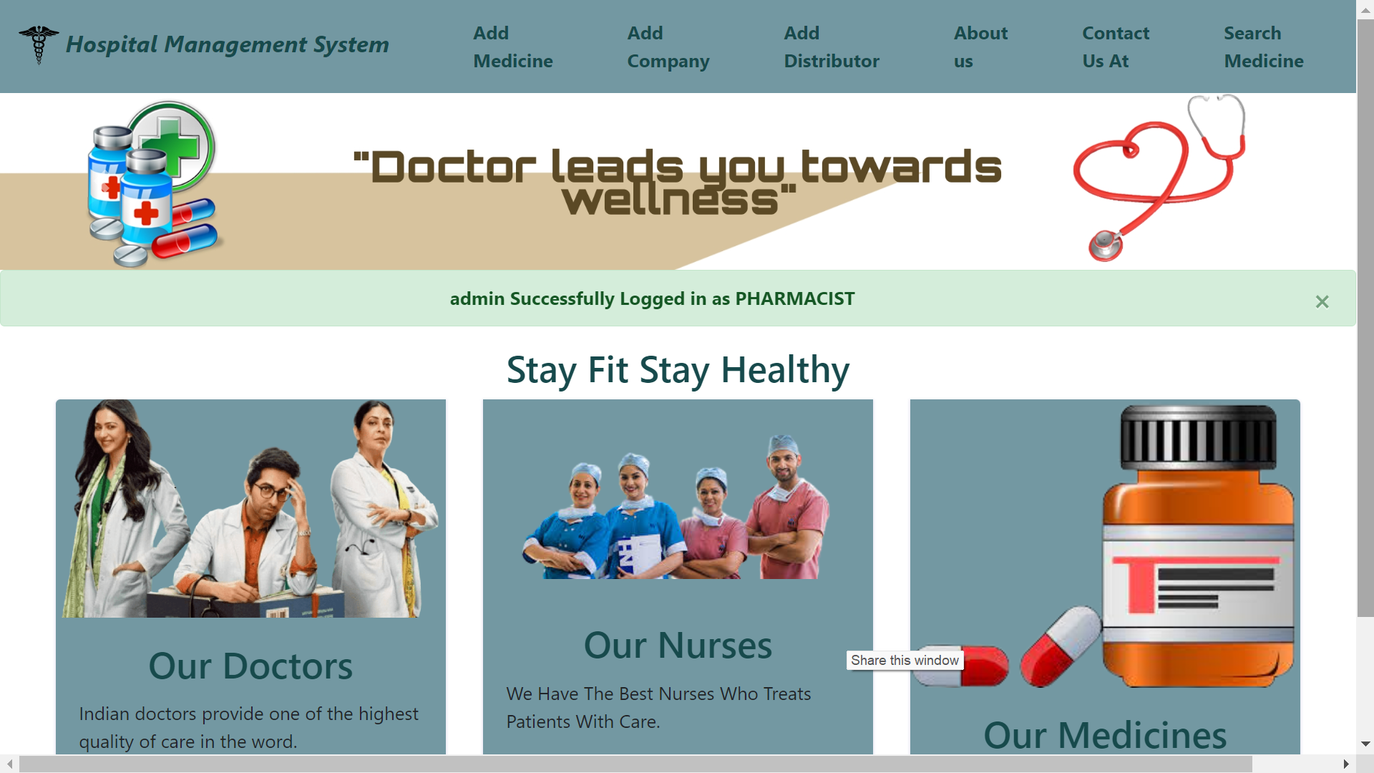
Demo
Pharmacist Login
16 | © 2018 QuEST Global Services Pte Ltd.
10

Slide 17
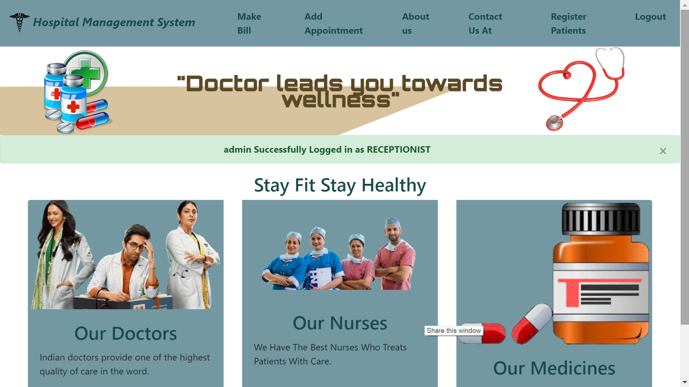
Demo
Receptionist Login
17 | © 2018 QuEST Global Services Pte Ltd.
10

Slide 18
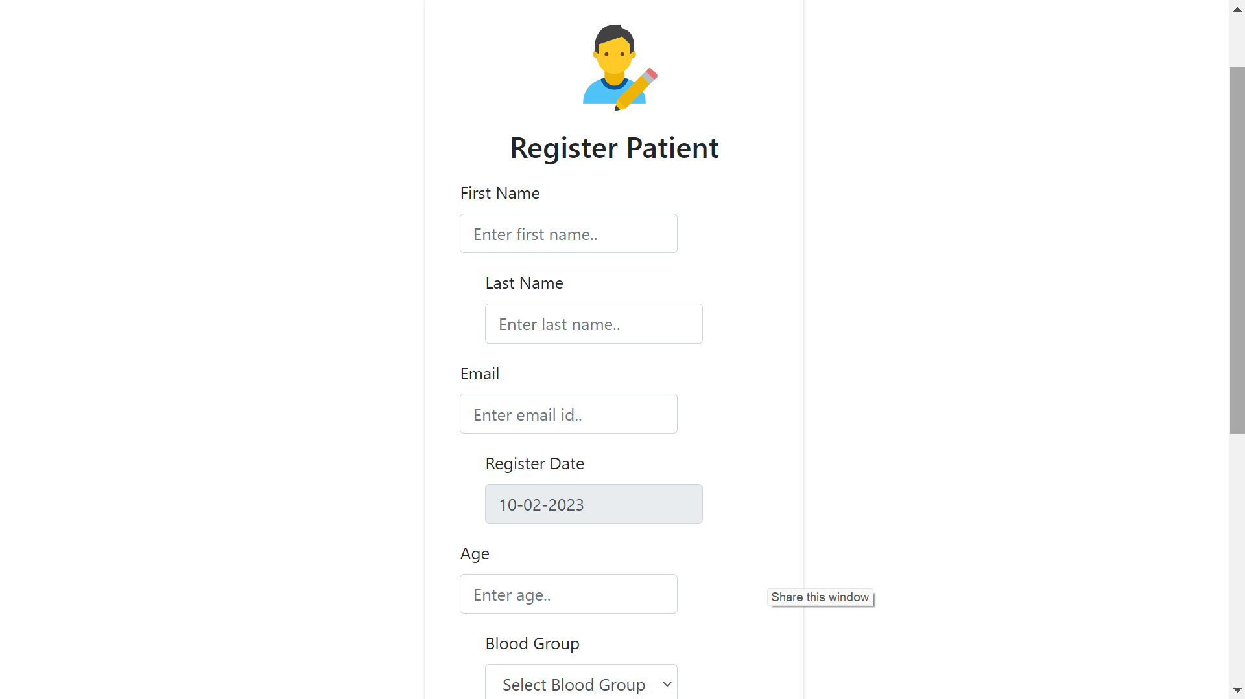
Demo
Patient Registration
18 | © 2018 QuEST Global Services Pte Ltd.
10

Slide 19
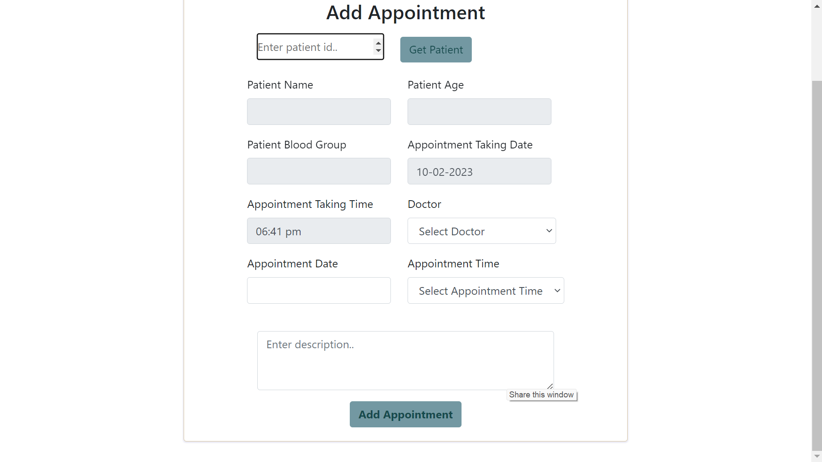
Demo
Appointment
19 | © 2018 QuEST Global Services Pte Ltd.
10

Slide 20
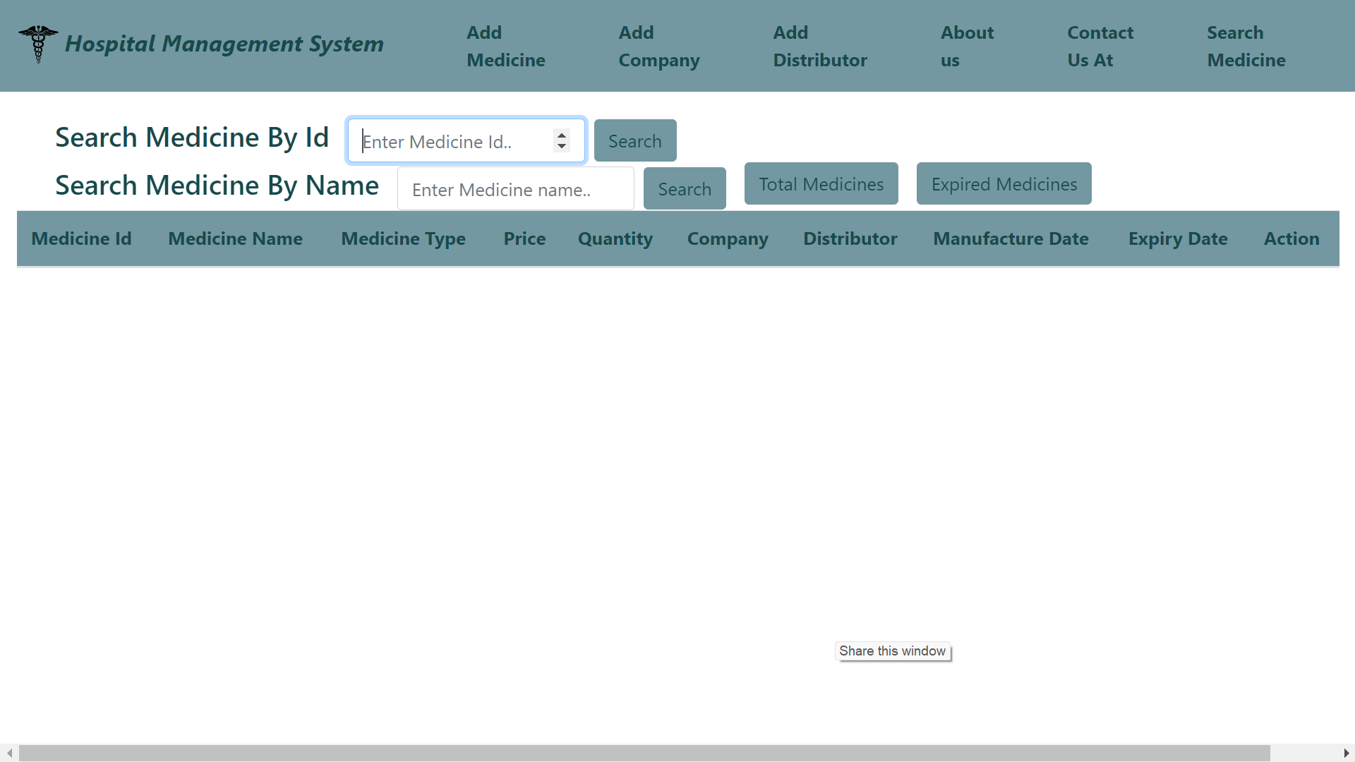
Demo
Search Medicine
20 | © 2018 QuEST Global Services Pte Ltd.
10

Slide 21




Thank You
© 2018 QuEST Global Services Pte Ltd. The information in this document is the property of QuEST Global Services Pte Ltd. and may not be copied or communicated to a third party or used for any purpose other than that for which it is supplied without the written consent of QuEST Global Services Pte Ltd.
13 | © 2018 QuEST Global Services Pte Ltd. Confidential

